Slide 1







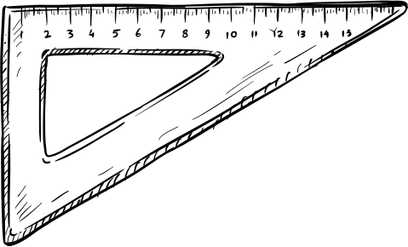
Examination & Evaluation System
Pokhara University

Slide 2


Academic Calendar
Academic Year Structure
  Pokhara University follows a Semester System
  Each academic year consists of two semesters
    Fall Semester: Starts in September
    Spring Semester: Starts in March
  Duration of each semester: 16 weeks= 4 months

Slide 3
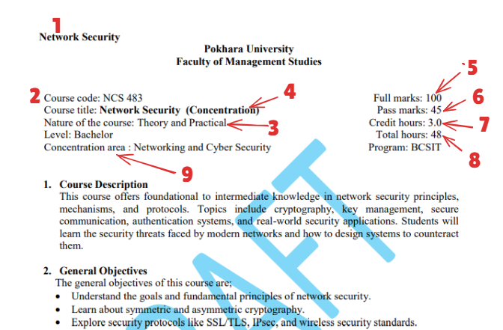
What????

Slide 4
Credit System
  Each course is assigned a fixed number of credit hours
  1 Credit Hour = 1 lecture hour per week per semester
  Minimum 16 class hours are required for 1 credit
  16 x 3 = 48 class hour
  Credit hours include:
    Lectures
    Tutorials & Practical/Lab work

Slide 5
Evaluation System Overview
  Student performance is evaluated in two phases:
    Internal Evaluation (50%)
    External Evaluation (50%)
  Students must pass both evaluations independently

Slide 6


Internal Evaluation (Theory Subjects)
Internal Assessment Breakdown
(50 Marks)
  Attendance – 2.5
  Discipline – 2.5
  Assignments – 5
  Project Work – 10
  Mid-Term Examination – 10
  Final-Term Examination – 20
  Total Internal Marks: 50

Slide 7
Internal Evaluation (Practical Subjects)
Practical Subject Assessment
  Theory Component: 25 marks
  Practical Component: 25 marks
Practical Marks Distribution
  Attendance – 5
  Lab Report – 5
  Practical Examination – 30
  Viva Voce – 10
  Total Practical Marks: 50

Slide 8
External Examination
  Conducted by:
    Office of the Controller of Examination, PU
  Examination is conducted externally
  Minimum pass marks: 45%
  Student must appear in both Terminal and Final exams
  Failure to appear results in NQ (Not Qualified)

Slide 9
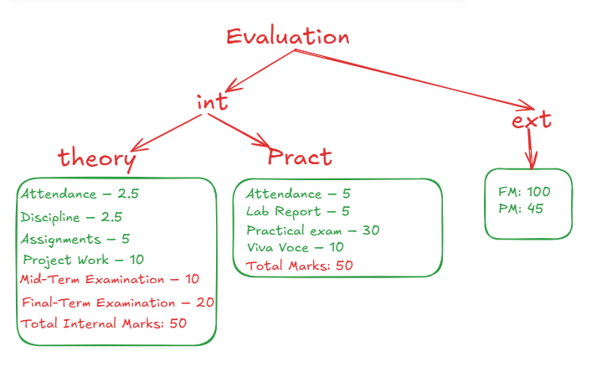

Slide 10
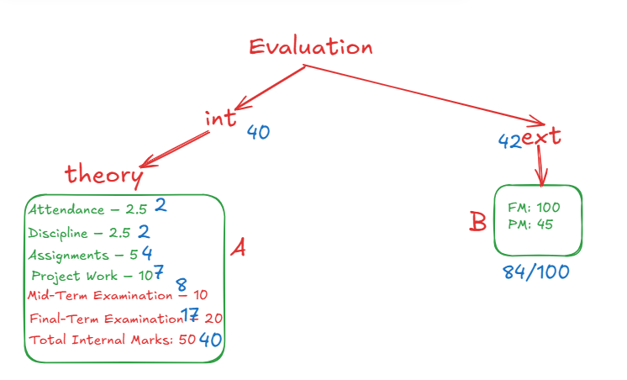

Slide 11
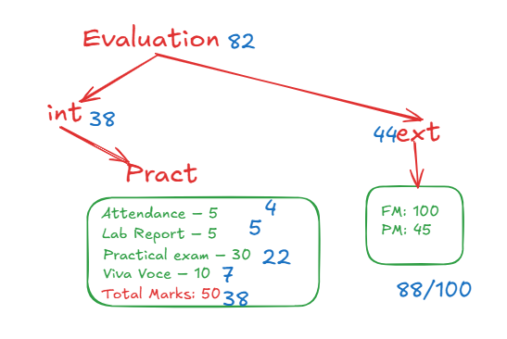

Slide 12


Congruency of Marks
Internal vs External Marks Consistency
  Internal and external marks should not differ unreasonably
  Maximum allowed variation: 25%
  If variation exceeds limit:
    Internal marks weight reduced by 50%
    External marks weight increased by 50%
  In case of persistent deviation:
    Entire batch results may be revised

Slide 13
Grading System
SGPA / CGPA

Slide 14
Grade-Based Evaluation
  Students are evaluated using Grades, not percentages
  Performance is measured through:
    SGPA – Semester Grade Point Average
    CGPA – Cumulative Grade Point Average
  Minimum CGPA required to continue program: 2.0

Slide 15
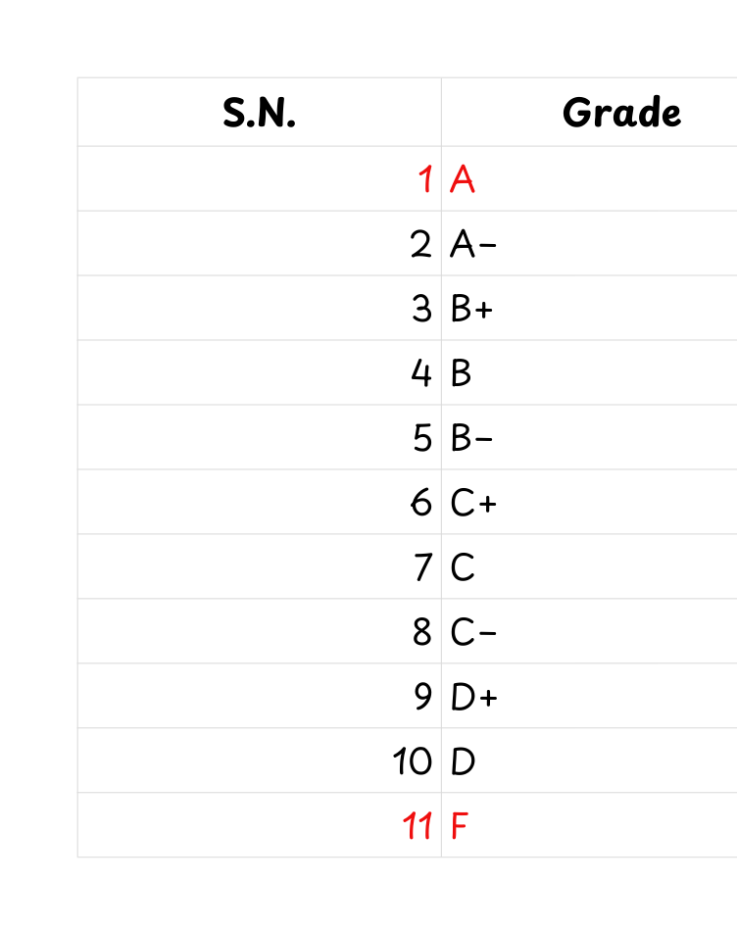
Grade-Based Evaluation

Slide 16
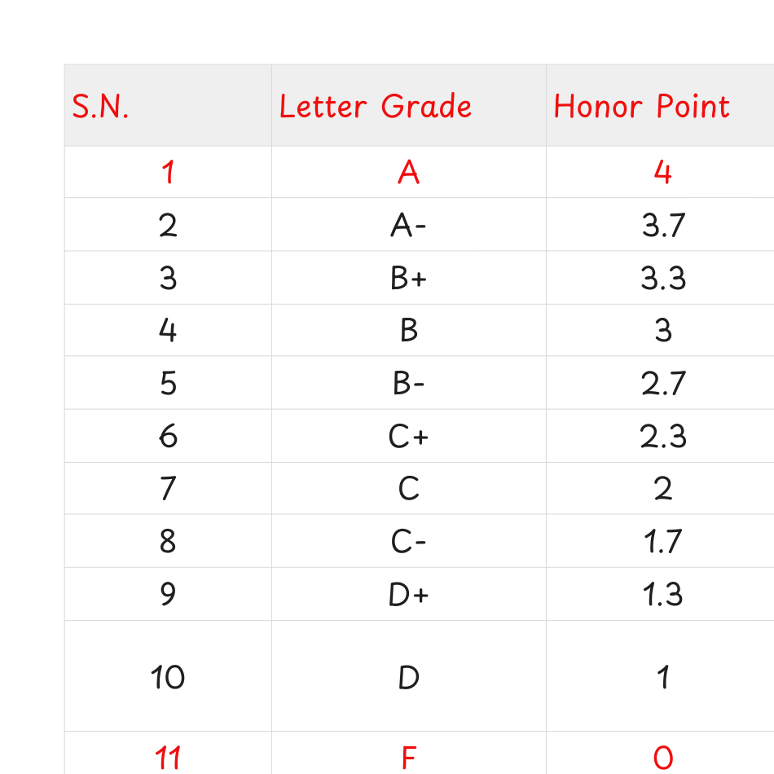
Grade-Based Evaluation

Slide 17
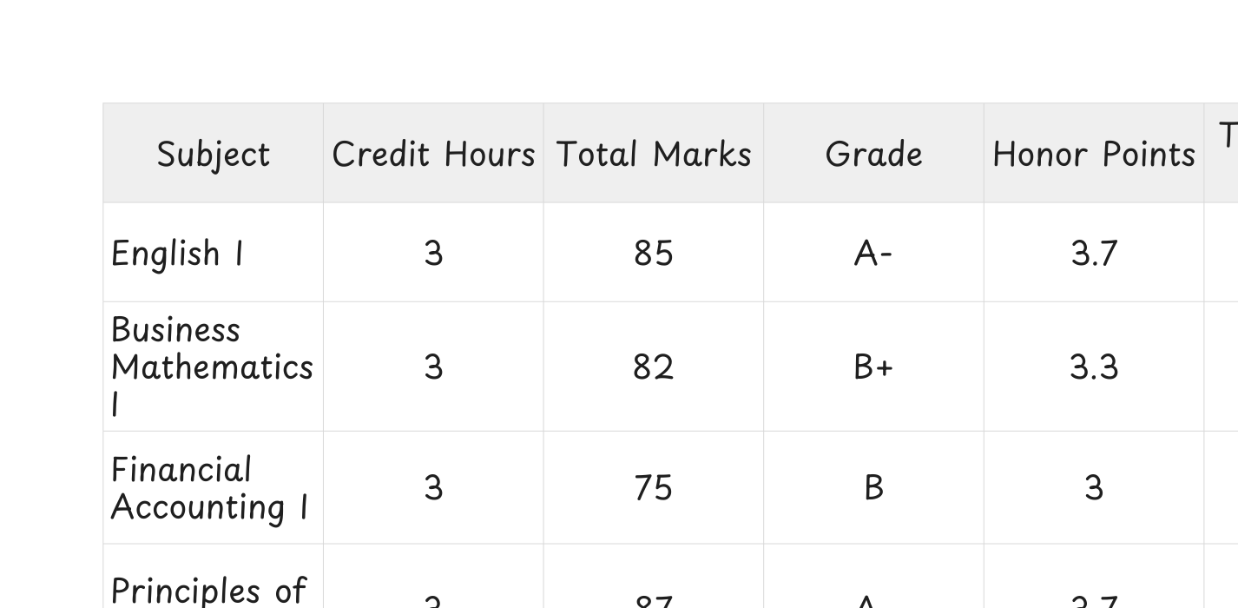
SGPA Evaluation

Slide 18
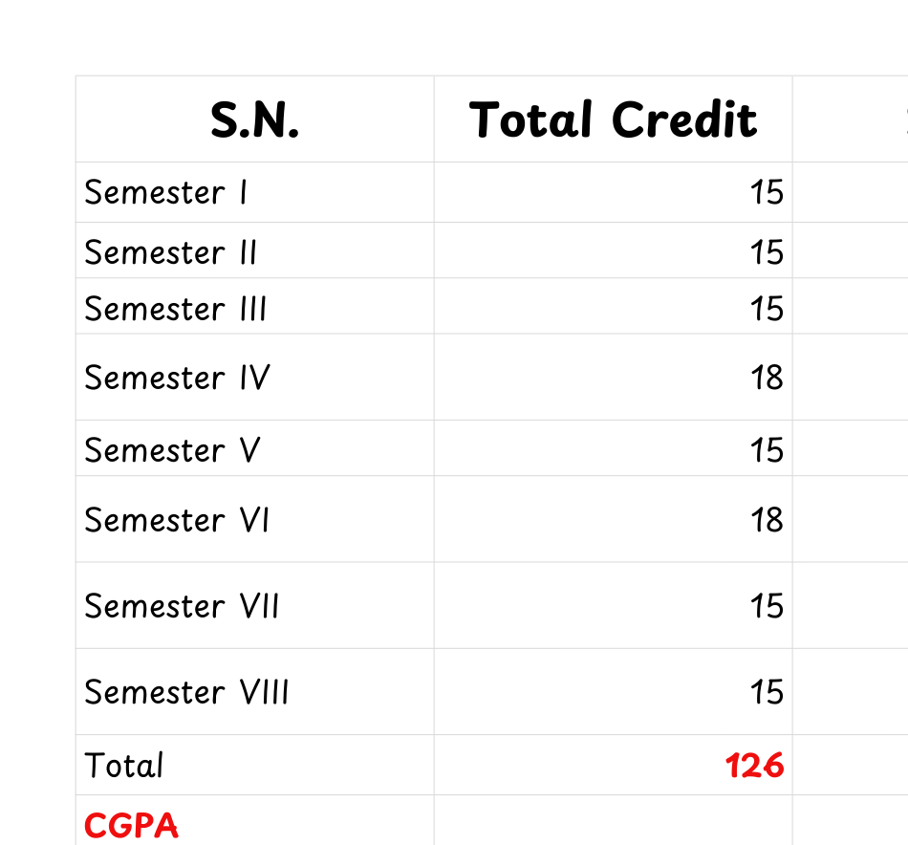
CGPA Evaluation

Slide 19
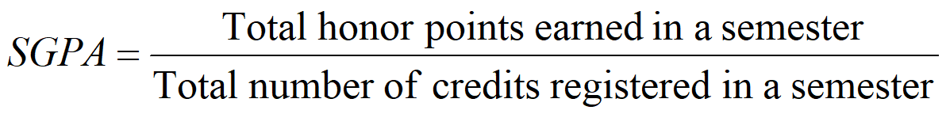
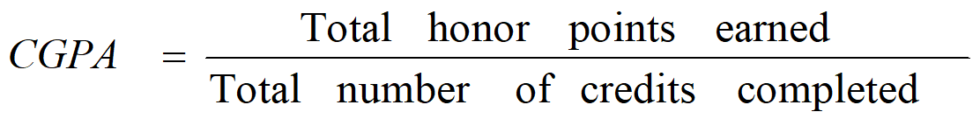

Slide 20
Academic Progress Rules
Continuation & Dismissal
  Students must maintain minimum CGPA of 2.0
  Students whose performance indicates inability to maintain CGPA:
    May be dismissed from the program
Always go CGPA > 3.5

Slide 21
Rechecking & Retotalling
Unsatisfactory / Failed Results
  Students may apply for:
    Rechecking
    Retotalling of grades
  Application requires payment of prescribed fee
  If grade changes:
    50% fee refunded
  If no change:
    Fee is non-refundable

Slide 22
Academic Recognition
Distinction & Dean’s List
  Degree with Distinction
    Minimum CGPA: 3.60
  Dean’s List Certification
    Minimum CGPA: 3.70
  Recognizes outstanding academic performance

Slide 23
Credit Transfer Policy
  Maximum 25% of total credits can be transferred
  Credit transfer is allowed from:
    Recognized national or international institutions
  Minimum Grade Requirement
    Grade B or above → External institutions
    Grade C or above → PU affiliated colleges

Slide 24


Transfer Conditions
  Transfer within same PU affiliated colleges:
    Must complete first semester in the same college
  Transfer to another university (within Nepal):
    Must complete one academic year (2 semesters)
    Minimum Grade B=3 required
  Transfer to international university:
    Must complete two academic years (4 semesters)
    Minimum Grade B required

Slide 25
Student Responsibilities
  Maintain regular attendance
  Complete assignments & projects on time
  Appear in all internal & external examinations
  Follow university rules and academic discipline

Slide 26

Thank You
Welcome to
CCT
Sanjeev Thapa, Er (BE-Comp, MTech-CSE, MBS, Mphil-Scholar, CKA, RHCSA, Openstack, MTCINE ....

